Slide 1

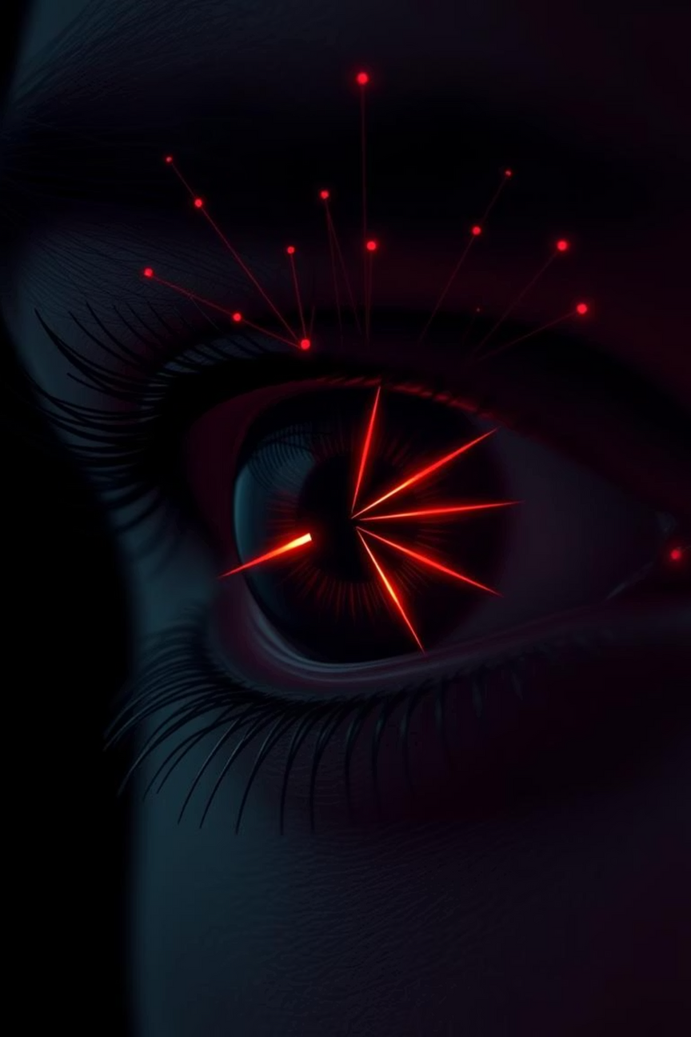

FER2013 Emotion Classification
Using ResNet18 with Transfer Learning
by Samikshya Karki
Notes:
1

Slide 2
Dataset: FER2013 & Emotion Categories
The FER2013 dataset serves as the foundation for our facial expression classification project. This extensive collection of grayscale images is labeled to categorize human emotions, enabling our model to identify a wide range of human sentiments.
Angry
Disgust
Fear
Happy
Neutral
Sad
Surprise
Notes:
2

Slide 3
Dataset & Preprocessing
Dataset Overview
Preprocessing Steps
FER2013: Facial Expression Recognition Dataset
Resize: All images to 224x224 pixels
Train Split: ~28,000 images
Normalization: Standardized using ImageNet means and standard deviations
Validation Split: 15% of testing data
Test Split: Remaining images
Data Augmentation: Horizontal flip, Rotation (up to 15 degrees), Affine Transformations (shear, translate)
Notes:
3

Slide 4



Model Architecture
Backbone Model
Output Layer Modification
Optimization & Loss
ResNet18, pre-trained on the extensive ImageNet dataset, providing a strong foundation for feature extraction.
Adam optimizer with a learning rate of 0.001 to efficiently navigate the loss landscape. CrossEntropyLoss as the objective function.
A custom final layer consisting of a Dropout (0.4) for regularization, followed by a Linear layer mapping to 7 emotion classes.
Notes:
4

Slide 5

Training Process
Epochs: The model was trained for 15 epochs to allow for sufficient convergence.
Iteration Cycle: Each epoch involved a standard training loop: forward pass, loss computation, backward propagation, and parameter update.
Performance Tracking: Key metrics, including training and validation loss, and accuracy, were diligently monitored and stored in a history dictionary for subsequent analysis and curve plotting later.
Notes:
5

Slide 6

Results
68.67% Test Accuracy
Our ResNet18 model, leveraging transfer learning, achieved a final test accuracy of 68.67% on the FER2013 dataset. This indicates strong performance in classifying facial expressions into the 7 defined emotion categories.
Notes:
6

Slide 7
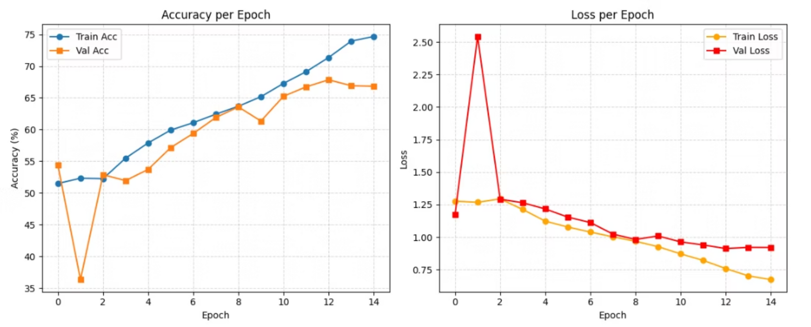
Accuracy and Loss Curves
Notes:
7

Slide 8



Conclusion
Strong Performance
Generalization
Future Potential
ResNet18, combined with transfer learning, demonstrated notable effectiveness in classifying emotions on the FER2013 dataset.
Strategic use of data augmentation and normalization significantly improved the model's ability to generalize to new, unseen data.
Further enhancements could involve exploring deeper architectures or fine-tuning techniques to push performance boundaries.
Notes:
8

Slide 9
Thank You!
Notes:
9

